Slide 1



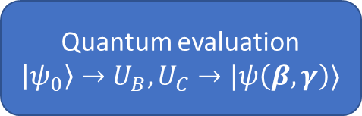
Quantum approximate optimization algorithm
Initialize $β$ and $γ$
On repeat:
Prepare $\left|ψ\left(β,γ\right)\right\rangle$
Compute $E\left(β, γ\right)$ by measurement
Update $β$ and $γ$
Output $\left|x\right\rangle = |ψ\left(β_{opt},γ_{opt}\right)⟩$ with lowest energy $E(β_{opt}, γ_{opt})$
$$β, γ$$
Classic optimization
Update $β, γ$
Quantum evaluation
$\left|ψ_{0}\right\rangle →U_{B},U_{C}→|ψ\left(β, γ\right)⟩$
$$E\left(β,γ\right)$$

Slide 2
Homework example teaser

Slide 3
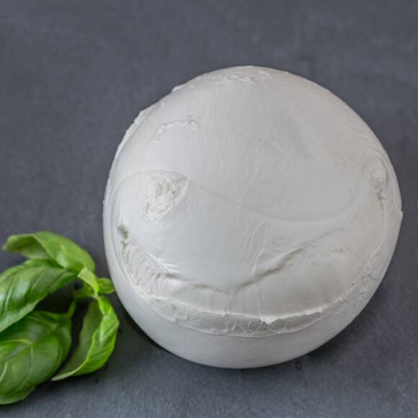
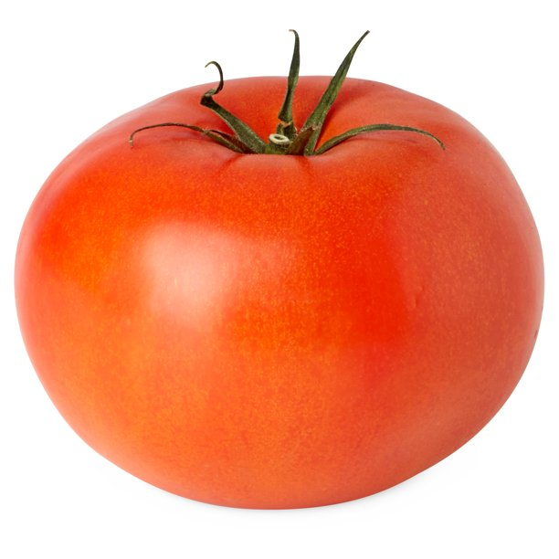
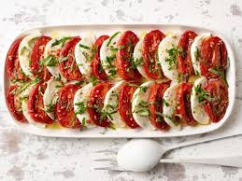
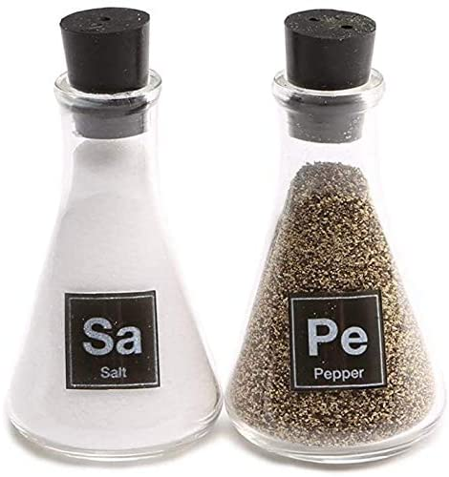
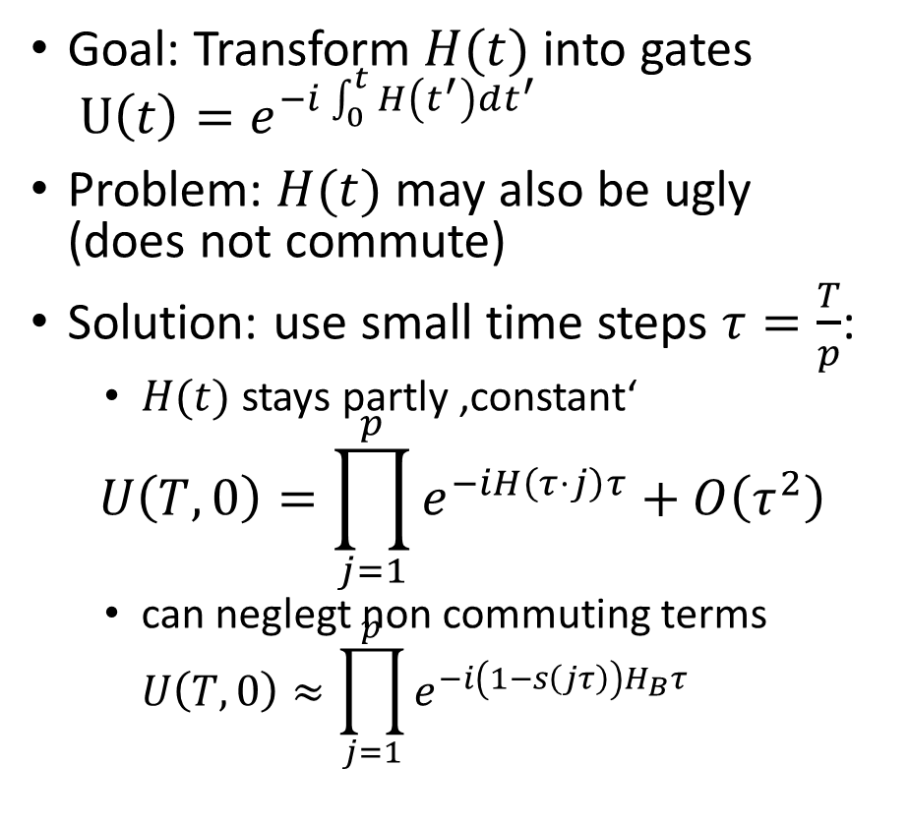
Cooking guide to Trotterization
$$H_{B}$$
$$H_{C}$$
Goal: Transform $H(t)$ into gates $U\left(t\right)=e^{−i\int_{0}^{t}{H\left(t^{′}\right)dt^{′}}}$
Problem: $H(t)$ may also be ugly (does not commute)
Solution: use small time steps $τ=\frac{T}{p}$:
$H(t)$ stays partly ‚constant‘
$$U\left(T,0\right)=\prod_{j=1}^{p}{e^{−iH\left(τ⋅j\right)τ}}+O\left(τ^{2}\right)$$
can neglegt non commuting terms $U\left(T,0\right)≈\prod_{j=1}^{p}{e^{−i\left(1−s\left(jτ\right)\right)H_{B}τ}}⋅e^{−is\left(jτ\right)H_{C}τ}$

